Slide 1
Homelessness and brain injury: The invisible disability in an invisible population
Steph Grant & Rebecca Forrester
#HomelessHealth17

Slide 2
Rates of head injury in homeless populations are reported between 43-53%*
Rates of hospitalised head injury are 5 times greater for the homeless population**
People with unrecognised neuropsychological needs often ‘bounce’ between services or remain invisible
*Mackelprang, Harpin, Grubenhoff & Rivara, 2014; Hwang et al., 2008
**MacMillan et al., 2014

Slide 3
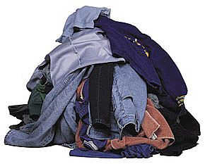
Wearing many cloaks of invisibility
Trauma
Violence
Housing
Hunger
Alcohol use
Drug use
Crime
Mental health difficulties
Physical health difficulties…

Slide 4
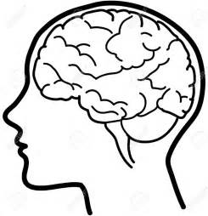
What difficulties might we see?
Attention
Concentration
Memory
Organising & planning
Emotion regulation
Anger & irritability

Slide 5
“How and why do some brain injured people become homeless?”

Slide 6
Further reading and contacts
Experiences of homelessness and brain injury (Brooks & Grant, 2016)
Not my First Rodeo video on homelessness and brain injury on YouTube (2nd place UKABIF film awards)
www.neurotriage.com

Slide 7
Thank-you for listening
Special thanks to:
Ste Weatherhead, for always keeping us cool, calm and connected

